Slide 1
TESTING CHALLENGES
by Băraș Flaviu Cosmin

Slide 2
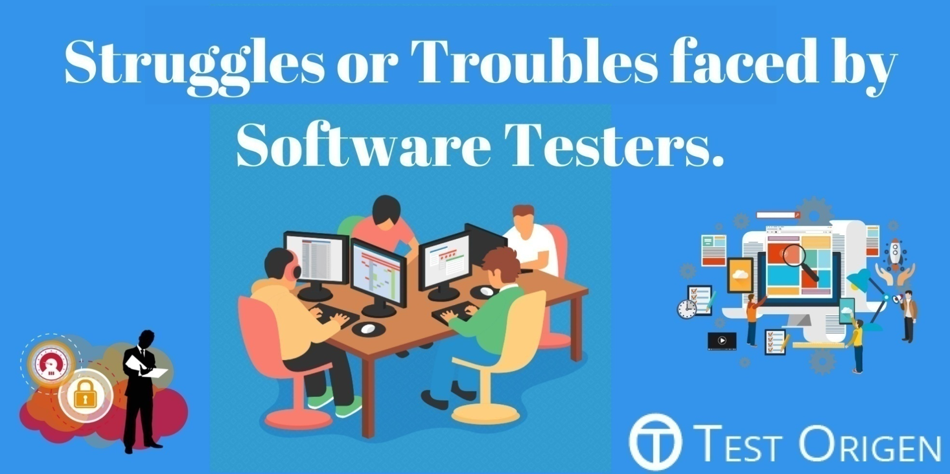
TESTING CHALLENGES

Slide 3
ffffffffff
1.Challenges in automation testing
2.Challenges of the Mobile Application Testing
3.Personal and other challenges faced by the testers

Slide 4

1.Challenges in automation testing
Good candidates for automation are tests that are difficult to run manually and those that are too complex for manual testing. In cases of testing the object-oriented software systems, because it is difficult for testers to understand the code and prepare the test cases, it is absolutely necessary to automate the tests.

Slide 5

In the future the general tendency is that the industry of software testing to pass towards automation testing. So the testers must develop their knowledges in various programming software and to learn automation testing. Automating testing save time and cost, but the process can’t be automated completely. Automation will not replace manual testing. When testers have to deal with massive quantities of data, they must implement automated testing tools.

Slide 6
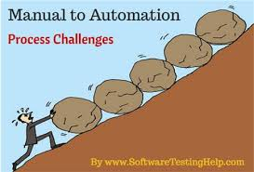
Automation can be an awesome productivity booster within testing teams and a quality enhancer for your systems when used correctly. The key is to make sure that it is used the right way, which is the hardest part when starting out. Here we will look at the most common test automation challenges and how to overcome them.

Slide 7
Challenge 1. Receiving the Green Light from Management
Testers may already know that automation offers both business and IT benefits (decrease time to market, increase test coverage and accuracy, decrease cost per hour, find bugs sooner, etc), but how can testers convince the finance department and the QA director to allocate the necessary time and funds for implementing test automation?
To prove to management that the financial benefits are substantial, testers will demonstrate how a team of testers could hypothetically reduce the cost of testing and increase number of testing.
It is important to also be very transparent with any and all stakeholders. Don’t lie to them and say that automation doesn’t require much effort up front, because it surely does, but in the end, it’s worth it!

Slide 8
Challenge 2. Selecting and Using the Appropriate Tools
Many teams do not get past this phase due to several reasons. They may lack the expertise to use a certain tool, the tool they want doesn’t exist, the tool or set of tools do not offer 100% test case coverage, the cost of a tool exceeds the test budget, etc.
If you don’t have a sufficient base knowledge for how to use a tool, you have a few options:
Take an online course
Have someone that helped create the tool come and give training sessions
Hire a consultant to help you master it
When all else fails, outsource. It may be quicker to simply hire someone who already has the expertise to use it and employ him or her for your automation project.
If you think a tool doesn’t exist, it might be good to confirm it with the testing community. If you can’t find it, you might want to see if it’s feasible or worthwhile to create it yourself.

Slide 9
If the tool you have doesn’t do everything you need, consider finding a multi-tool solution. Remember, it’s impossible to test absolutely everything, but you can use the tools that test the most important things.
Lastly, If a tool is out of the budget, do a quick cost vs. benefit analysis and present your case. You can measure the damage done by a previous bug you have encountered and show how much time and money you could have saved if you had the tool in place. Also, you can also present them the informations that the automation will improve the efficiency of the activity.

Slide 10
Challenge 3. Identifying a Starting Strategy
Ok, so you might have all the tools and the support to begin automating, but what do you actually automate and how? Unfortunately, the tools themselves do not tell you what to automate! In reality, you can’t automate everything so you have to be strategic.
Test automation is really just automatically checking the system, while humans are still needed to do the non-automated testing. Also, remember that the value of a test comes from the information that it provides, not the number of tests executed, nor the frequency. What we care most about is if we are getting the right information so that we can make the best possible decisions when improving the quality of our systems.
Make sure your team and management agree on and understand the desired outcome(s) from your automation plan so that everyone is on the same page!

Slide 11
Challenge 4. Automated test oracles
A challenge with automation is that automated testing requires automated test oracles (an oracle is a mechanism or principle by which a problem in the software can be recognized). Such tools have value in load testing software (by signing on to an application with hundreds or thousands of instances simultaneously), or in checking for intermittent errors in software.
Challenge 5. Test planning
The success of automated software testing depends on complete and comprehensive test planning. Software development strategies such as test-driven development are highly compatible with the idea of devoting a large part of an organization's testing resources to automated testing. Many large software organizations perform automated testing. Some have developed their own automated testing environments specifically for internal development, and not for resale.

Slide 12
Challenge 6. To cope up with new / modified requirements
Sometimes requirements are changed / added in between the project milestones. It becomes a challenge to cope up with the new changes within the deadline and making sure that all the old ones are working properly.
Challenge 7. Technical Challenges
Test automation needs to be reliable so that when it fails, it is because of incorrect system behavior, not a problem with automated tests.
A solution may be to run the tests as often and repeatedly as you can, especially during the night.
Solution. Good cooperation with the developers is needed to resolve the problems that could appear in automatability and testability.
Challenge 8. The costs of automated testing tools
The automated testing tools are expensive but it is worth to pay the costs.
Challenge 9. Appear many versions of programs
New versions of programs appear periodical, and also new versions of operating systems (like Windows) are developed.

Slide 13
Challenge 10. Negative testing in driver code
Testing error paths in driver code is also a significant problem. Because most drivers run in kernel mode, where software has direct access to all hardware resources, errors in driver code – even a simple unhandled message – can cause a system fault (also known as the dreaded blue screen of death). Driver code contains a huge proportion of error-checking code. Only a percent of the code in a driver, runs when encountering error conditions. Testing these errors paths has traditionally been extremely difficult. Diligent developers will step through each of their error paths in the debugger, but a large number of error paths remain untested, until someone – usually a customer working on something unbelievably important – reproduces just the right environment to trigger that error, crash his or her machine and lose that work.
Challenge 11. Operating systems compatibility
Challenge 12. Lack of experience
A big challenge is the lack of experience with virtualization required for the setup and maintenance of multiple test systems with different configurations.

Slide 14
Challenge 13. Multiple data
In relational databases, updating a record can write data in multiple tables, and cause update to multiple indexes. The data record are contained in multiple files (called tables) and programs reference, some subset of the fields of data across the database. Problems would occur when a user request a data while another user is in the process of updating the database record.
Solution. A way to look for errors is to generate lots of database activities from multiple users at the same time. The goal is to produce tests that would generate lots of conditions and could detect the bugs and provide enough failure information to the developers so they could isolate the cause and have some chance at fixing the bugs.
Challenge 14. Nonfunctional quality attributes
-such as: reliability, robustness and recoverability.
Challenge 15. Pressing hotkeys
Hotkeys are keyboard shortcuts used in the application.
Challenge 16. Testing devices
All the testers face this huge challenge.

Slide 15


Slide 16
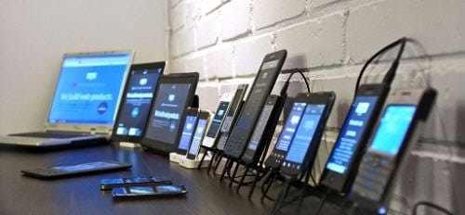
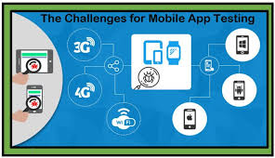
2.Challenges of the Mobile Application Testing

Slide 17
hChallenge 1.Operating systems
Testing is a industry that is constantly changing. The movement towards mobile devices has brought a whole different set of challenges to the testing world. Mobile application run on top of new operating systems that are still only partially reliable. Many mobile applications have failures because of the operating systems problems. New versions of mobile operating systems are frequently released, not always backward compatible with previous versions. This means that testers have to test that the app developed support older OS versions and older API’s.
Challenge 2.Mobile devices network connectivity
Mobile device connectivity has several standards for mobile data connection such as(edge, wi-fi, umts, 3G, 4G, 5G) and the testers should try to test the application against each one of them. The real challenge comes when trying to test on 3G and lower data connections since most of them are out of use and most of the devices only use 4G.
The mobile app tester has to cross check that the application works smoothly on all the networks. To get this done the tester has to ensure that he executes the tests on all the network types.

Slide 18
Challenge 3.Multiple mobile devices
A huge challenge is represented by the multitude of mobile devices. Exists multiple mobile platforms & versions. The rate of smartphone adoption is growing. Coming up with bug-free and well-tested mobile apps can be challenging due to the diversity involved in mobile app testing and quality analysis. Performance testing is more costing, complex, consuming comparing to the desktop and web application. Testers must test the various devices and operation systems in different networking conditions. Providing testing coverage for all the devices is a major challenge, even for the big organizations.
To cope with the changes in the mobile devices and the platforms, it is important for the testers to stay updated with the latest trends in the industry.
Challenge 4.Power consumption and battery life
The innovation in the battery storage capacity field hasn’t been as quick as in the app consumption. We are running lots of apps during the day and several processes are running on background without us even noticing. When testing mobile apps we need to make sure that the power consumption is kept minimal and the app is developed by keeping the best practices in mind.

Slide 19
Challenge 5.Usability
Mobile device screens are relatively small and there are always more data we would like to present than possible to fit to the screen. It’s challenging to keep the interaction clean and simple for the user, and at the same time display all the necessary information. Font size and readability are other challenging factors of usability.
Challenge 6.Internationalisation
Most of the apps are designed to be used on international markets. Testers should also take into account regional traits (locale settings, timezones), target audience and most important, translation.
Challenge 7.Many different testing tools
Another obstacle for developers and testers is the choice of the right tools for mobile app testing. There are so many tools out there that it is impossible to choose from, unless you have a mobile testing strategy and you know exactly what you need to make your testing plan happen.
Challenge 8.The Time constraints
Users demand shorter delivery time days for a mobile app which ties up the process of testing. Ample timelines need be framed for effective testing and later release.

Slide 20
Challenge 9. Browsers compatibility
Mobile browsers are optimized so as to display Web content most effectively for small screens on portable devices. Mobile browser software must be small and efficient to accommodate the low memory capacity and low-bandwidth of wireless handheld devices. Typically, they were stripped-down web browsers, however, some recent mobile browsers can handle latest technologies also such as CSS 2.1, JavaScript and Ajax.
Challenge 10. Data security
With a massive amount of critical and personal information being shared and stored, securing the data has become a significant part of mobile testing. Applications are prone to malicious activities like security trespasses, and hence need strict security tests and constant monitoring. The U.S. government has initiated an extraordinary outreach campaign to foreign allies, trying to persuade wireless and internet service providers in these countries to avoid telecommunications equipment from China’s Huawei Technologies Co., because they intrude into the lives of people and spy them.

Slide 21
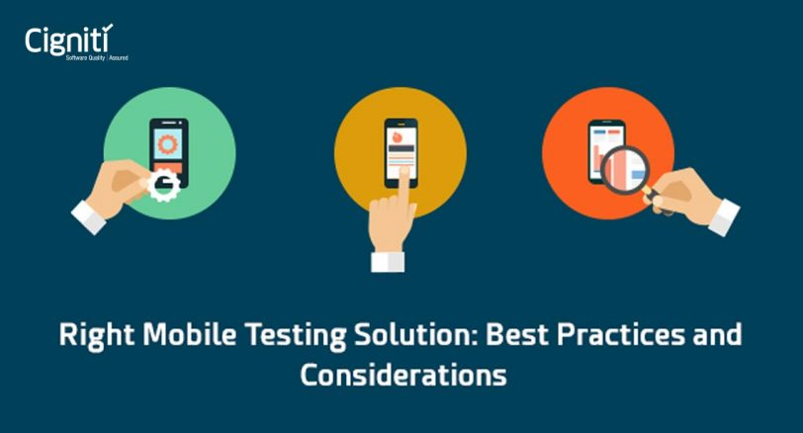
2.1.Solutions for mobile testing

Slide 22
1.Mobile Test Lab
If your mobile test needs are immense and often, a good idea is to invest in creating your own mobile test lab. Or one can as well look for solutions to hire an external test lab or explore the cloud mobile lab solutions. this lab will ensure that you have not simply tested your app on an emulator or simulator but on the actual real device. Also, you have catered well the variability of OS, device type, fragmentation, screen, memory and other factors which can impact your application functioning on the mobile device.
2.The Right Testing Solution
The most crucial part of mobile applications testing is the test automation. In automation testing the right solution is using one of the many solutions available in the market- Robotium, Appium, Calabash from open source, and in commercial – eggplant, perfecto etc adapted at the app specifications. The tester needs to have an understanding of which tool can help him in executing the process. The decision is based on the operating system the application belongs to, followed by the fact that the tool is free or paid. The existing automation tools for testing on mobile devices essentially use record and playback.

Slide 23
3.Using emulators and simulators as a testing tool
Emulators have limitations. Emulators and simulators are merely approximations of devices that can give a false sense that applications support all test requirements like performance, security and fault-tolerance in different geographies and networks. The software version they emulate is not always up-to-date and does not follow regularly the real life firmware versions. In addition they do not offer advanced testing capabilities like automation that can significantly speed up the testing process and save valuable resources.
Mobile applications that are free of faults and errors provide a better user experience which has a direct impact on the business side of the application, so the tester job has a great impact over the quality of the product.

Slide 24



3.Personal and other challenges faced by the testers

Slide 25

3.1.Personal challenges of testers and solutions for these
The thoughest challenge currently faced by the testers appear to be those involving their relationships with other people.

Slide 26
Challenge 1. Building Relationships with Developers
The challenge is to move from the ”us versus them” mindset to the interdependent teamwork approach “us and them”. Inevitable conflicts and tensions arise between the developers and the test team. It’s very important that the testers to have the right attitude toward the developers, to speak warmly with them and diplomatically. They are not adversars, but members of the same team. The challenge is to obtain the right balance of rigorous testing and cooperation in order to function as an effective team.
Solutions: The primary solution is to view testing as a win-win activity that involves many people, tools, throughout a project’s life cycle. Teamwork is essential.
1.1)Organize testing to involve people from all aspects of the project.
1.2)Focus on the product, not the producer.
1.3)Pay attention to the cultural issues.
1.4)Secure and maintain management support.

Slide 27
Challenge 2. Testing Without Tools
An automated test tool, combined with an effective testing process, reduce the time required to test basic functions and allow the testers to focus on critical tests. In some cases it’s possible to have billions of possible test cases. There is too much work for the test team to handle (sometimes are hundred of tests to be done). Tests must be rerun if defects are found and changes are made. A test that takes an hour to perform manually can be performed in a minute or less with an automated test tool.
Solutions: Educate Management on the use of test tools and obtain support from the leadership. Accurate test repeatability can only be accomplished by using automated test tools. In some cases, the option is to build your own tools.
2.1)Raise awareness.
2.2)Increase understanding.
2.3)Set expectations.

Slide 28
Challenge 3. Explaining Testing to Managers
Management needs to understand that effective testing is a matter of following basic principles and that support is needed for tools, processes and people. Without management leading the way, the testing effort will be limited in effectiveness.
Solutions:
3.1)Identify the Stakeholders at the Management Level.
3.2)Raise awareness in the importance of testing.
3.3)Network with Other Organizations to learn how they deal with Management.

Slide 29
Challenge 4. Communicating with Customers and Users
The challenge is: discerning the customers from the end-users and gaining agreement in spite of any political issues that may arise. The people sponsoring the project (the customers) and the people benefiting from the system (the end-users) each have their own sets of success and failure criteria.
Solutions: The solutions to identifying the customers and end users and meeting their needs depend on three concepts: teamwork, communication and continuous involvement. The customers need to know exactly what is going on.
4.1)Keep talking, even if it means disagreeing.
4.2)Don’t confuse meetings, names and e-mails with effective communication. Communication is not only what you say, but how you say it.
4.3)If there is a communication barrier, seek help from the services of a facilitator.
4.4)Communicate tactfully.
The end of the project is the worst time to find out that the system will not meet the business as operational needs of the end-users. The solution is continuous involvement in the project to minimize the expectation gap (the difference between what the user expects and what the user gets).

Slide 30

Challenge 5. Making Time for Testing
The challenge that testers have is to fit their testing into the box and sometimes the box gets smaller if other parts of the project fall behind schedule. Realizing what is really going on in terms of time helps people to set more realistic expectations of what can be accomplished. Capacity to manage well time, to take the right decision, to know when to give up. Like developers, the testers are also required to perform all tests within a stipulated timeframe. Complete and perfect testing is impossible.
Testers have less time than they think they have. Tired, burned-out people are not very attentive to finding defects. They must have strong organizational work skills and to be with an eye to detail. Poor planning and coordination were identified as one of the reason project failed.

Slide 31
Solutions: Automated testing tools helps the testers to leverage their time. However, the challenge remains to test the right conditions, as opposed to as many conditions as possible.
5.1)Control the Scope of Testing
You should not bite off more than you can chew.
Relate test objectives to system or project objectives.
5.2)Control Management Expectations.
When pressured into a last-minute “rush job” ask management “which part do you want me to test?”
5.3)Base Test Cases on an independent Set of Criteria. In many projects testers need to do testing, but don’t have the specification documents, so it is a big challenge to explore the system and find the bugs. Not defining requirements is also a weak and unreliable way to build a system.
5.4)Perform Risk Assessments. Prioritize items to be test by risk. Testers need to prioritize test cases and perform the high risk cases first and work their way down to the lowes risk cases.
5.5)Reuse Your Testware.
Design test plans, test scripts, test data that can be used in future at the same software or as templates for future projects.

Slide 32
Challenge 6. Testing What’s Throw Over the Wall
Traditionally, developers and testers don’t talk to each other. When the developers are finished building a software programme or system, they sometimes unceremoniously dump the product on the testers. This tendency is often called the throw-it-over-the-wall syndrome.
Rework is costly, especially when defects migrate to a later phase of software development, as in the case of moving from construction to testing. When defects are not caught close to the source of creation, people waste time sending the work back to the creator of the product. This cycle can escalate into so many loops that it seems the software will never see production.
It’s very bad not to find the bugs at the early cycle of the project. The testing activity should started as earlier as possible because it will help in fixing enormous errors in early stages of software development and reduces the rework of tracking bugs in the later stages. Sometimes testers find big problems when they are at the deadline and the developers don’t have necessary time to fix them. Unidentified bugs could causes future software failure.

Slide 33
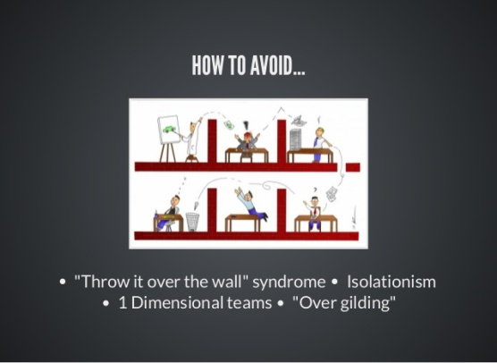

Solutions:
6.1)Get Management Support to Define Roles and Responsibilities.
6.2)Establish Standards and Processes for Testing.
6.3)Establish Ownership and Accountability at the Developer Level.
6.4)Train Developers to be excellent testers.
6.5)Improve Communication between Developers and Testers.

Slide 34
Challenge 7. Hiting a Moving Target
Testers face the challenge of trying to test a continually changing system with criteria that don’t always manage to change along with it. What works well in isolation (for example in unit testing) might fail completely when combined with other parts of the system (for example during integration and system testing).
Changes impact testing in the form of:
7.1)Rework of testware.
Test scripts, test plans and test cases should be designed for change.
7.2)Regression testing of Previously Tested Software.
Every time the system (hardware, software, peripherals and so forth) is changed, there is a risk that a new defect will be revealed. This is sometimes called the I-just-changed-one-line-of-code syndrome.
7.3)Backlog created by Rapid Change.
The best solution is to automate testing.
Solution: The optimal solution is to control the changes, instead of just tracking them or surrendering to them. Until changes are controlled, systems will be difficult and expensive to build.

Slide 35

3.2. Other challenges faced by the testers
Challenge 8.Domain knowledge
This is one of the biggest challenges that testers faces. Testers must learn permanently and improve their knowledges related to what they do. They must be rapid learners. They must have technical knowledges, like MySQL, Databases, networking, web design.
Challenge 9.Ability to think analytic, to think outside the box.
Testers must find defects which are not easy to find by the users.
Challenge 10. Have Passion
Testers must have passion and enthusiasm for testing. They must be super – motivated and take initiative at work.

Slide 36

3.3.Challenges faced by distributed teams
What Is a Distributed Team?
A distributed team can be defined as people who are working in one group but are separated by their geographical locations. It can be in a different time zones, a neighboring city or even in a different building. The links of a distributed team are strengthened by reliable webs of communication technology.

Slide 37
Challenge 1.Non-native English speakers
In a distributed team a great challenge is the communication in various languages between the people. Some or all distributed team members may not have the same first language, some members may not speak the language used by the team, or team members may not be able to easily undersand one another because of accents. In multinational environments, testers don’t have the same native language (understand the spoken language of their fellow workers.)
If the members of the team are non-native English speakers, they will be shy to speak up. This might lead to lack of effective communication that might be costly to the team in the long run. So they must improve their languages.
Time zone mismatch misunderstandings about meetings dates and times occur more often with a distributed team working in different time zones than with a collocated team. Scheduling team action and tasks become more challenging with increasing levels of distribution. Furthermore, the time zone mismatch has a psychological aspect as well. This is because the mood and attitude change throughout a day, most people are more vigilant and alert in the morning and more thoughtful and emotional in the evening.

Slide 38
Challenge 2.Lack of In-person Interaction
Distributed teams make it extremely difficult to judge the body language, have one-on-one conversations or even stop by a colleague's desk. In addition, it is not possible to read emotions, pick up clues or even feel the energy inside a room beyond the scope of a colleague's webcam.
Challenge 3.Us Versus Them
This is normally a big problem for geographically distributed teams. It develops underneath the surface with people unawares. People become friends with those at the office and sideline those are not around. It is a mindset that deteriorates collaboration over the course of time.
Challenge 4.People Come from Various Cultures
Cultural differences can also impact the effectiveness of a team’s communication and collaboration. Identifying points that need clarification is especially critical to align the team’s efforts with the expectations of the Product Owner. The members of the team must speak up when they do not understand something.

Slide 39
Challenge 5.The black box
The remote team members are far away and we don’t see what they’re doing or even who’s working on our projects. And in a way we don’t even want to. The remote team is a ‘black box’. We send in requirements and expect output.
Not knowing where to locate files and the correct version of files to be working with are dysfunctions that plague many distributed teams.
Challenge 6.Technical problems that occur with security
Technical problems that occur with security – firewalls and access lists – can also create barriers that become more challenging with the geographically distributed teams.
Challenge 7.Good software engineering practices
Good software engineering practices are important for both collocated and distributed teams. But, for distributed teams, poor engineering practices are much more obvious and are a greater problem.

Slide 40


3.4.Solutions to the Challenges that Distributed Team Faces
Globally distributed teams can easily overcome some of the challenges that they face, especially with effective and robust tools for distributed team for remote collaboration and communication like ezTalks Cloud Meeting. When working with globale teams and using international calls is important that everyone can access the conference.

Slide 41
1. Video Chat over Calls
It is recommended that during conference calls, distributed team members should use video chat. This allows people to easily read the facial expressions of remote colleagues and that is invaluable for communication.
2. Employee Rotations
Members of a distributed team should be rotated between different locations. Moreover, the entire team should meet in a single location for quarterly/annual meetings, rallies and retreats. This allows them to know each other far from the work environment. This eliminates any existing barrier between members.
3. Expose Distributed Team to Clients
Most distributed teams suffer from a low exposure to clients and the market. This greatly improves the productivity of distributed teams.
4. Alliances between Teams
Animosity between members of a team usually results from a lack of understanding. This is why it is important to forge alliances between different distributed teams so that they learn to respect and support each other.
5. Exploring each other’s cultures
People must invest some time exploring each other’s cultures to get a better understanding of their cultural differences

Slide 42
5. Common Vision
Having a common vision for all members of a distributed team will unite and align them. This works well against the us vs them mentality that was earlier mentioned.
6. Connect People in a Creative Manner
When people are connected in a creative manner outside a typical video conference call, the culture barrier can be easily overcome with little difficulty. This can be over a social event where people can talk (Christmas party / Team buildings).
7. Story Sized Sections
Parsing the requirements into convenient story-sized sections and consequently sending them out as storyboards can solve the problem of requirements delivery process for distributed teams.
9. Improving english language (other common language)
The key to bo a good tester is to have a good communication, so all the members of the distributed team must improve their common language. In order to help testers, the employer could offer free language courses.
10. Take into account the national holidays of each team member When the resources and the time allocated to a certain project are established is important to take into account the national holidays of each team member.

Slide 43
Conclusions
When we talk about Automation, tester has to have some programming knowledge to write the scripts and also should show how to use automation tools really well. Is better for the manual testers to be open and think that a good solution for their problems will be to implement automated testing, which will make them 10 times more effective. To solve the automated testing challenge, there is much more to be done and much better solutions to come. The companies have to take the initiative and decide to improve processes, to look at the ways to achieve better testing in general and to increase the effectiveness and efficiency of the existing test automation in particular.
Testing of smartphones applications is very challenging, given the availability of a wide variety of configurations, languages, operator settings, and so on. The challenges of mobile testing are often unique to each business, and hence the solution too will depend on your context. The solution will be a mixture of tools, frameworks, platforms, and people, eventually striking the best balance between cost, quality, and time-to-market. You might have built a useful application, but to make it desirable it has to continuously delight its users. An efficient and effective mobile testing strategy forms the bedrock of delivering rock-solid, right-first-time applications.

Slide 44
It is crucial for the testers to improve their communication skills that are necessary in speaking with the developers and the clients in a clear, effective manner and understandable way. Testers communicate within the team members and with external teams. Testers must interact with people, discuss with developers, stakeholders, with Project Manager, CEO, business owners, (and so on). They have to speak with the clients to get more information. Communicating at different layers of organization is the key to any tester.
Sometimes testers are responsible for communicating with customers for understanding the requirements. Testers require good listening and understanding capabilities. Testers must have good communicating skills in order to build relationships with the developers. Also they need analyzing and problems solving skills. They should have a strong reason to prove why it is so important to fix the defect and what the after effects are if it is not fixed properly. Poor communication is a major cause of project failure and blocked lines of communication are absolutely detrimental to testing. Developers and testers should always cooperate with each other and they should also understand and respect the each other view.

Slide 45



Slide 46
References
1)A Practical Guide to Distributed Scrum, by Elizabeth Woodward, Steffan Surdek, Matthew Ganis, International Business Machines Corporation, 2010.
https://www.scribd.com/document/42021760/A-practical-guide-to-Distributed-scrum
2)Challenges and Techniques for Testing of Big Data, Naveen Garg, Dr. Sanjay Singla, Dr. Surender Jangra, www.academia.edu.
3)Challenges for software quality testers - How to improve your testing process
https://www.youtube.com/watch?v=BnfzjDAjUdI
4)Challenges in Manual Testing
https://www.youtube.com/watch?v=4RuFjcp_hPY
5)7 Challenges of Distributed Teams and How to Solve
https://www.eztalks.com/telecommuting/challenges-of-distributed-teams-and-how-to-solve.html
6)Challenges of Testing Mobile Applications, Ubaid Pisuwala
https://www.peerbits.com/blog/mobile-app-testing-challenges.html
7)Challenges & Problems In Usability Testing of Web Based Applications: A Study of Software Companies In Pune City, Dayanand S. Patil, Dr. Binod Kumar, www.academia.edu

Slide 47
8)Experiences of Test automation, Dorothy Graham, Mark Fewster,
https://www.scribd.com/document/247164361/Experiences-of-Test-automation
9) Huawei has 22 commercial 5G contracts; U.S. government warns allies about the company, Alan Weissberger, 23.11.2018, http://techblog.comsoc.org/2018/11/23/huawei-has-22-commercial-5g-contracts-u-s-government-warns-allies-about-the-company/
10)Issues, Challenges and Best Practices of Software Testing Activities, Zulkefli Mansor
https://pdfs.semanticscholar.org/4b99/91a1d098776f07340690b7a158ccf5a81016.pdf
11)Mobile Testing Challenges and Solutions XBOSoft Webinar, Ed Curran https://www.slideshare.net/xbosoft/mobile-testing-challenges-and-solutions-xbosoft-webinar 12)Mobile Testing: Challenges and Solutions, Philip Lew
https://www.slideshare.net/TechWellPresentations/mobile-testing-challenges-and-solutions
13)Skills Required for Software Testing Career
https://www.youtube.com/watch?v=FncYa_4b3zI
14)Software testing, https://www.scribd.com/doc/213947646/Software-Testing

Slide 48
15)Software Testing of Mobile Applications: Challenges and Future Research Directions, Henry Muccini, Antonio Di Francesco, Patrizio Esposito, www.academia.edu
16)Solutions to overcome Top 5 Manual Testing challenges
https://www.youtube.com/watch?v=reRgc_awnGQ
17)Surviving the top ten challenges of software testing, William E. Perry, Randall W. Rice
https://books.google.ro/books?id=QVYUAAAAQBAJ&pg=PT81&lpg=PT81&dq=testing+challenges&source=bl&ots=YrqrA3M6IP&sig=ACfU3U0vgLDOpAy1ztOGg1CfK2bmcw7Wng&hl=ro&sa=X&ved=2ahUKEwjg3aeE9fbfAhVq_SoKHRPSBls4ggEQ6AEwCHoECAAQAQ#v=onepage&q=testing%20challenges&f=false
18)Testing challenges https://www.google.ro/search?client=opera&hs=n15&ei=LsA3XP2LKvKHrwS-8b_ACg&q=testing+challenges+pdf&oq=testing+challenges+pdf&gs_l=psy-ab.3..0i22i30l2.1877.2871..3350...0.0..0.78.295.4......0....1..gws-wiz.......0i71j0.ioCq2GIcYYk
19)The Challenge of Good Enough Software, by Bach, J. http://www.satisfice.com/articles/gooden2.pdf (1995)

Slide 49
20)Top Challenges Faced by Testers During Software Testing @ TestOrigen
https://www.youtube.com/watch?v=O_CvO9DLXAQ
21)Top 10 Challenges Testers Face at Workplace and How to Overcome Them
https://www.softwaretestinghelp.com/challenges-testers-face-at-workplace/
22)What are some of the challenges facing software testers, James Bach
https://www.youtube.com/watch?v=bgRBoOOY3A4
23)What are the challenges that testers will face in future?
https://www.youtube.com/watch?v=uNopKJmKOsw
24)What is the most important skill a software tester should have?
https://www.youtube.com/watch?v=OLxaG0TNgMM
25)Why Software Requirements Traceability Remains a Challenge, Andrew Kannenberg, Dr. Hossein Saiedian
http://static1.1.sqspcdn.com/static/f/702523/9188499/1288392919397/200907-Kannenberg.pdf?token=Pz4FPwzyCeKwCp4pXz3zPVFBBI8%3D

Slide 50


